Slide 1
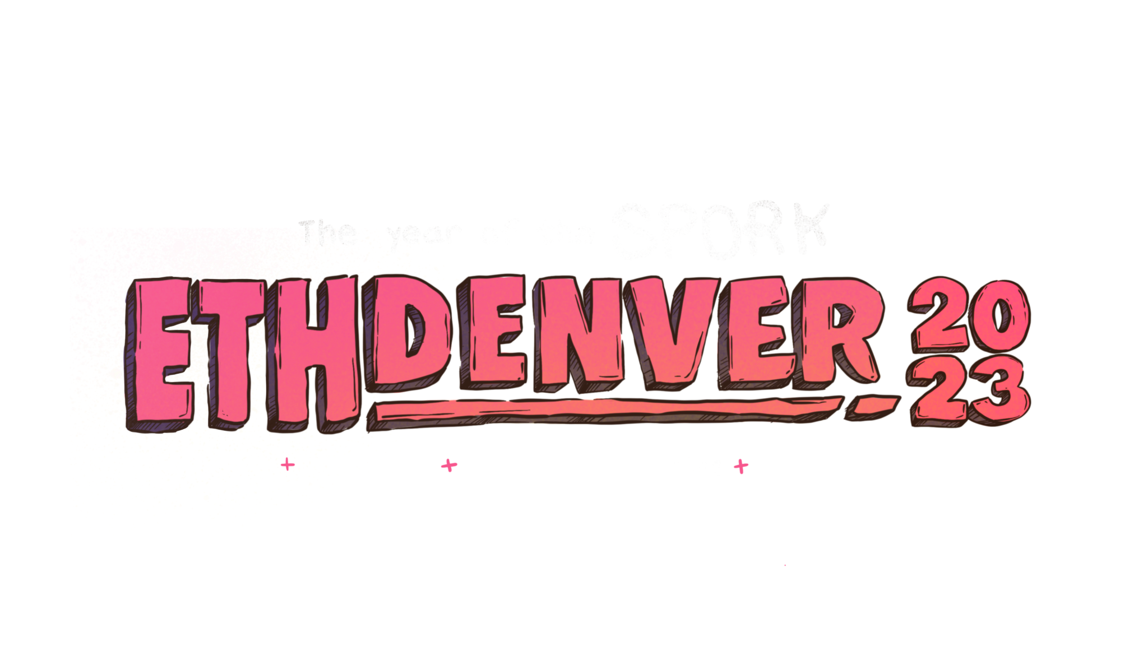

Slide 2
Introduction to Substrate, Polkadot,
and Upgrades
w/ Shawn Tabrizi (@shawntabrizi)
Camp #BUIDL 2023

Slide 3
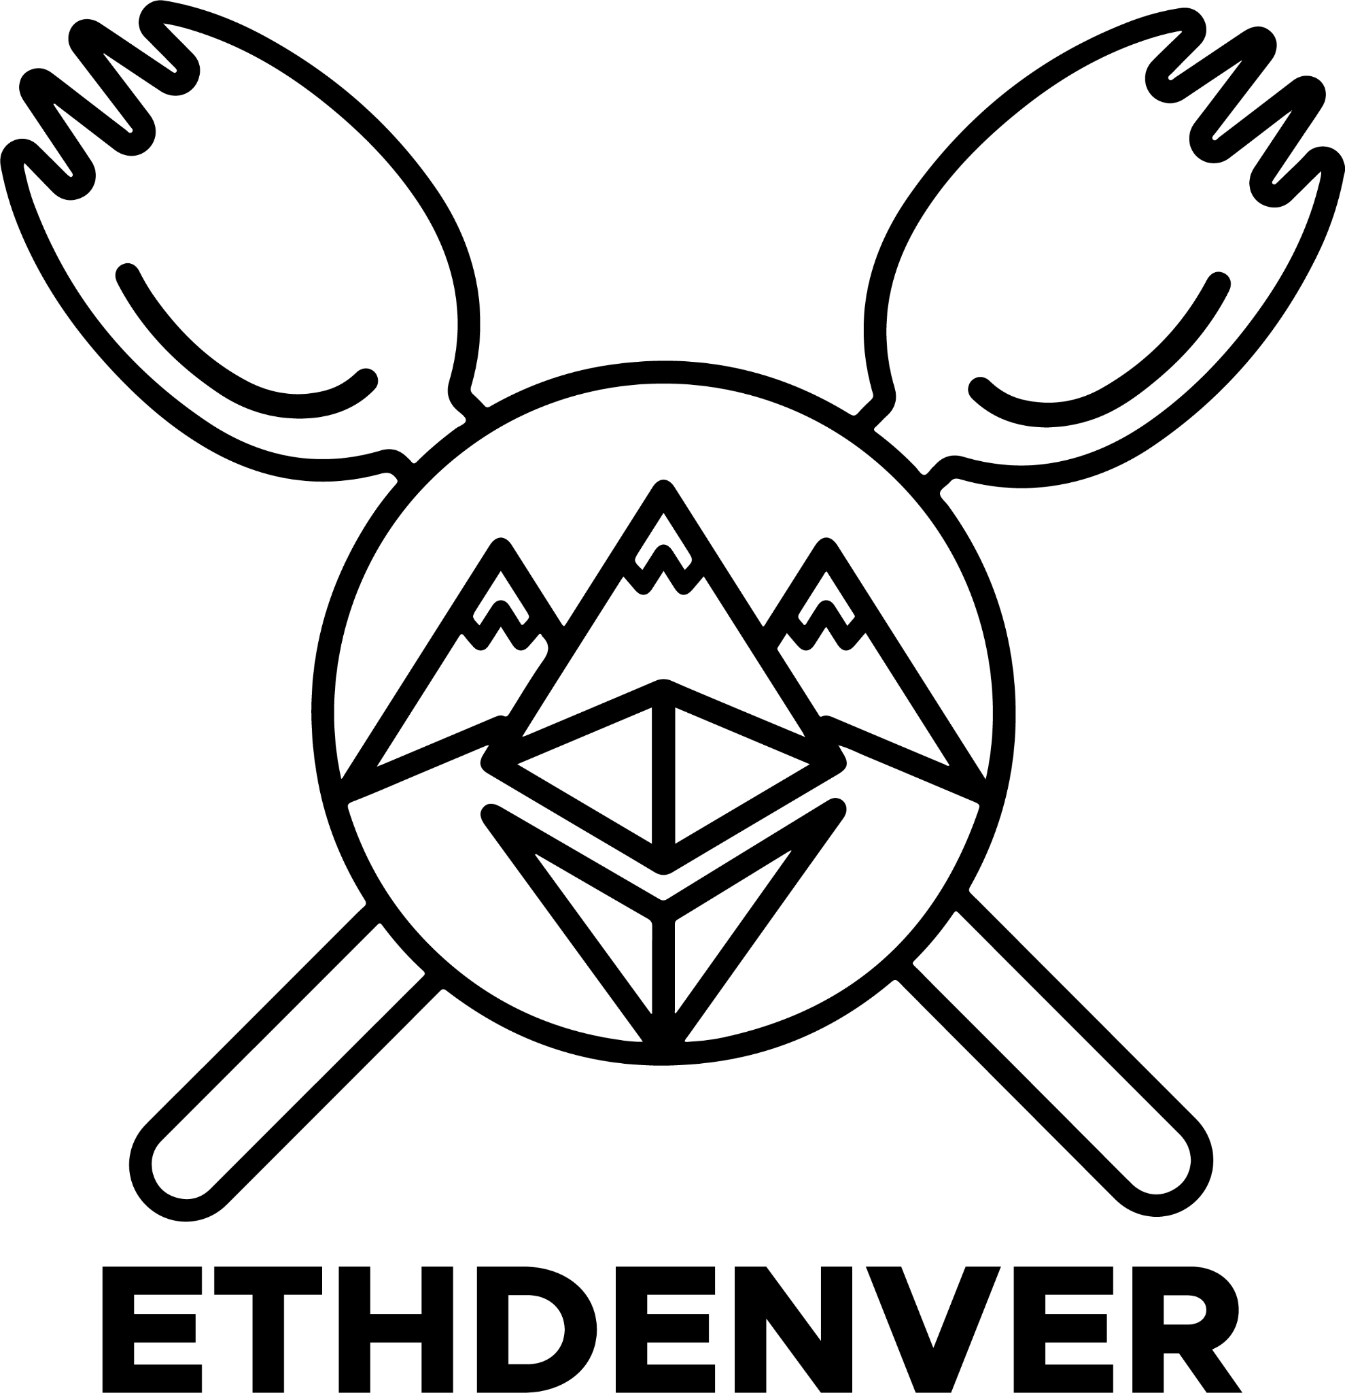
What we are going to cover:
What we are going to do:
What is Polkadot?
What is Substrate?
What is a Forkless Upgrade?
Build a Custom Blockchain
Sporklessly Upgrade the Blockchain
We will keep this brief, but you can always learn more on your own!
Sporkless

Slide 4


What is Polkadot?

Slide 5
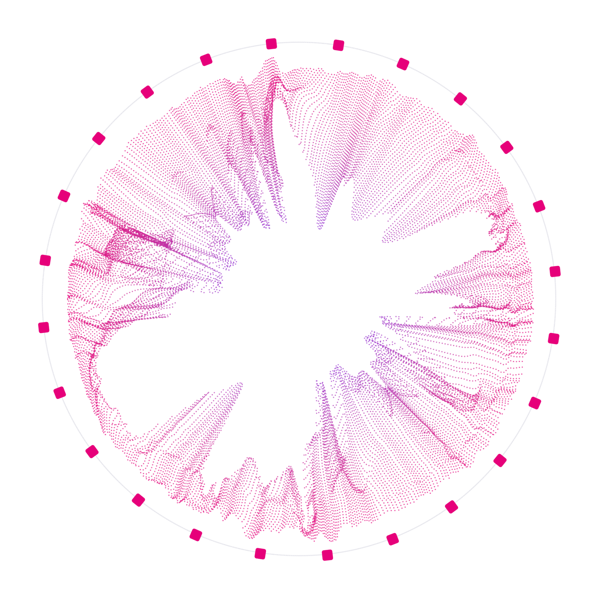
Polkadot is a network that connects blockchains.
A vision toward a multi-chain future.

Slide 6
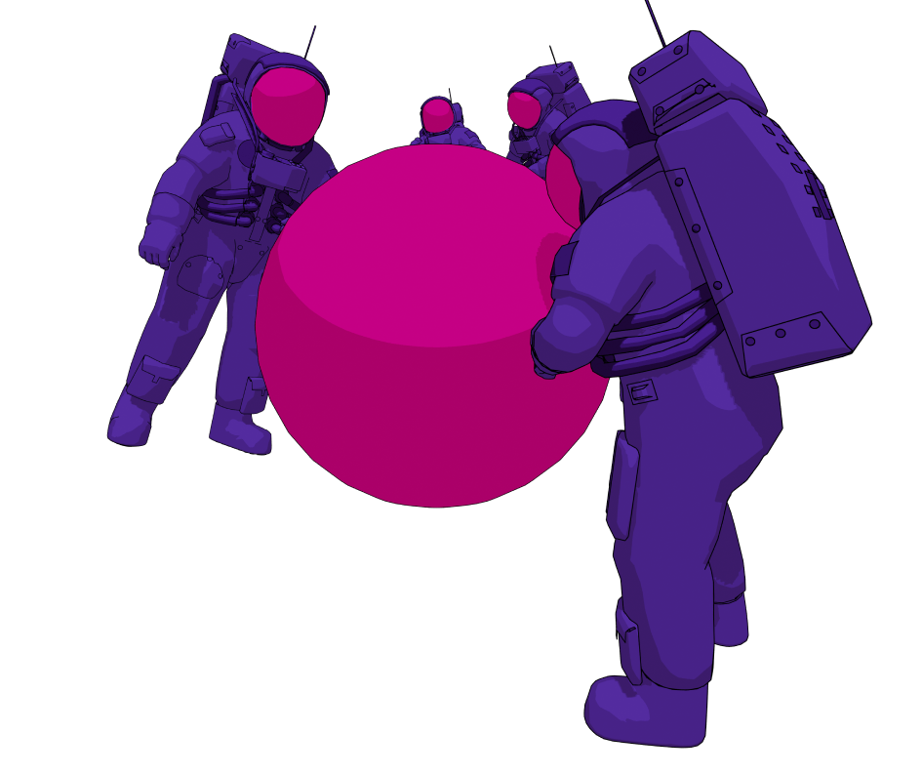
Polkadot’s Goals
Polkadot attempts to solve three problems:
Interoperability
Scalability
Shared Security.

Slide 7

Why a multi-chain future?
Blockchains can help solve trust problems.
Specialization can help solve scalability issues.
Interoperability can help add real world value.

Slide 8
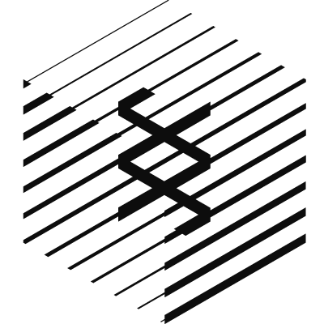
What is Substrate?

Slide 9
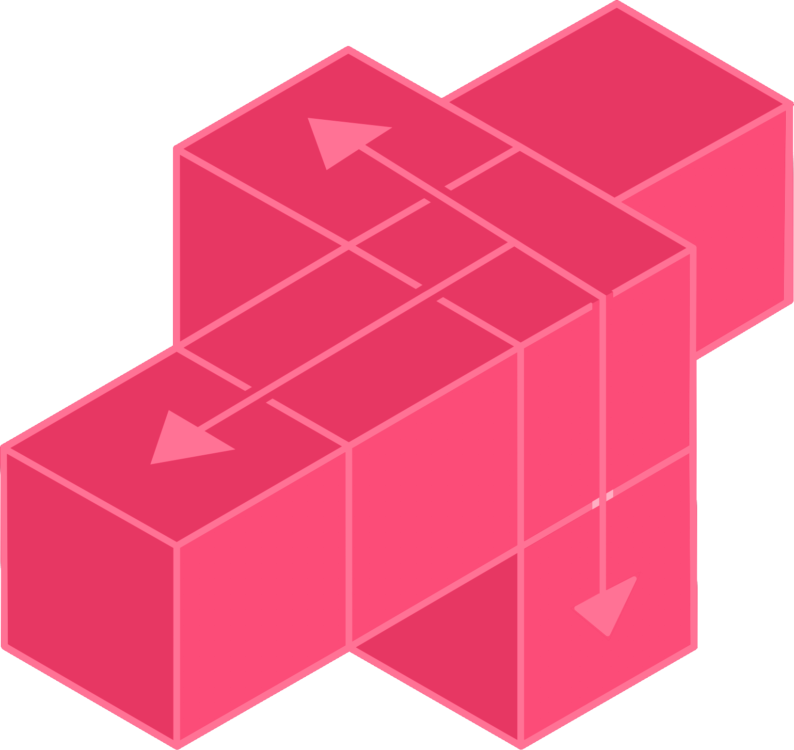
Substrate is an open source, modular, and extensible framework for building blockchains in Rust.

Slide 10
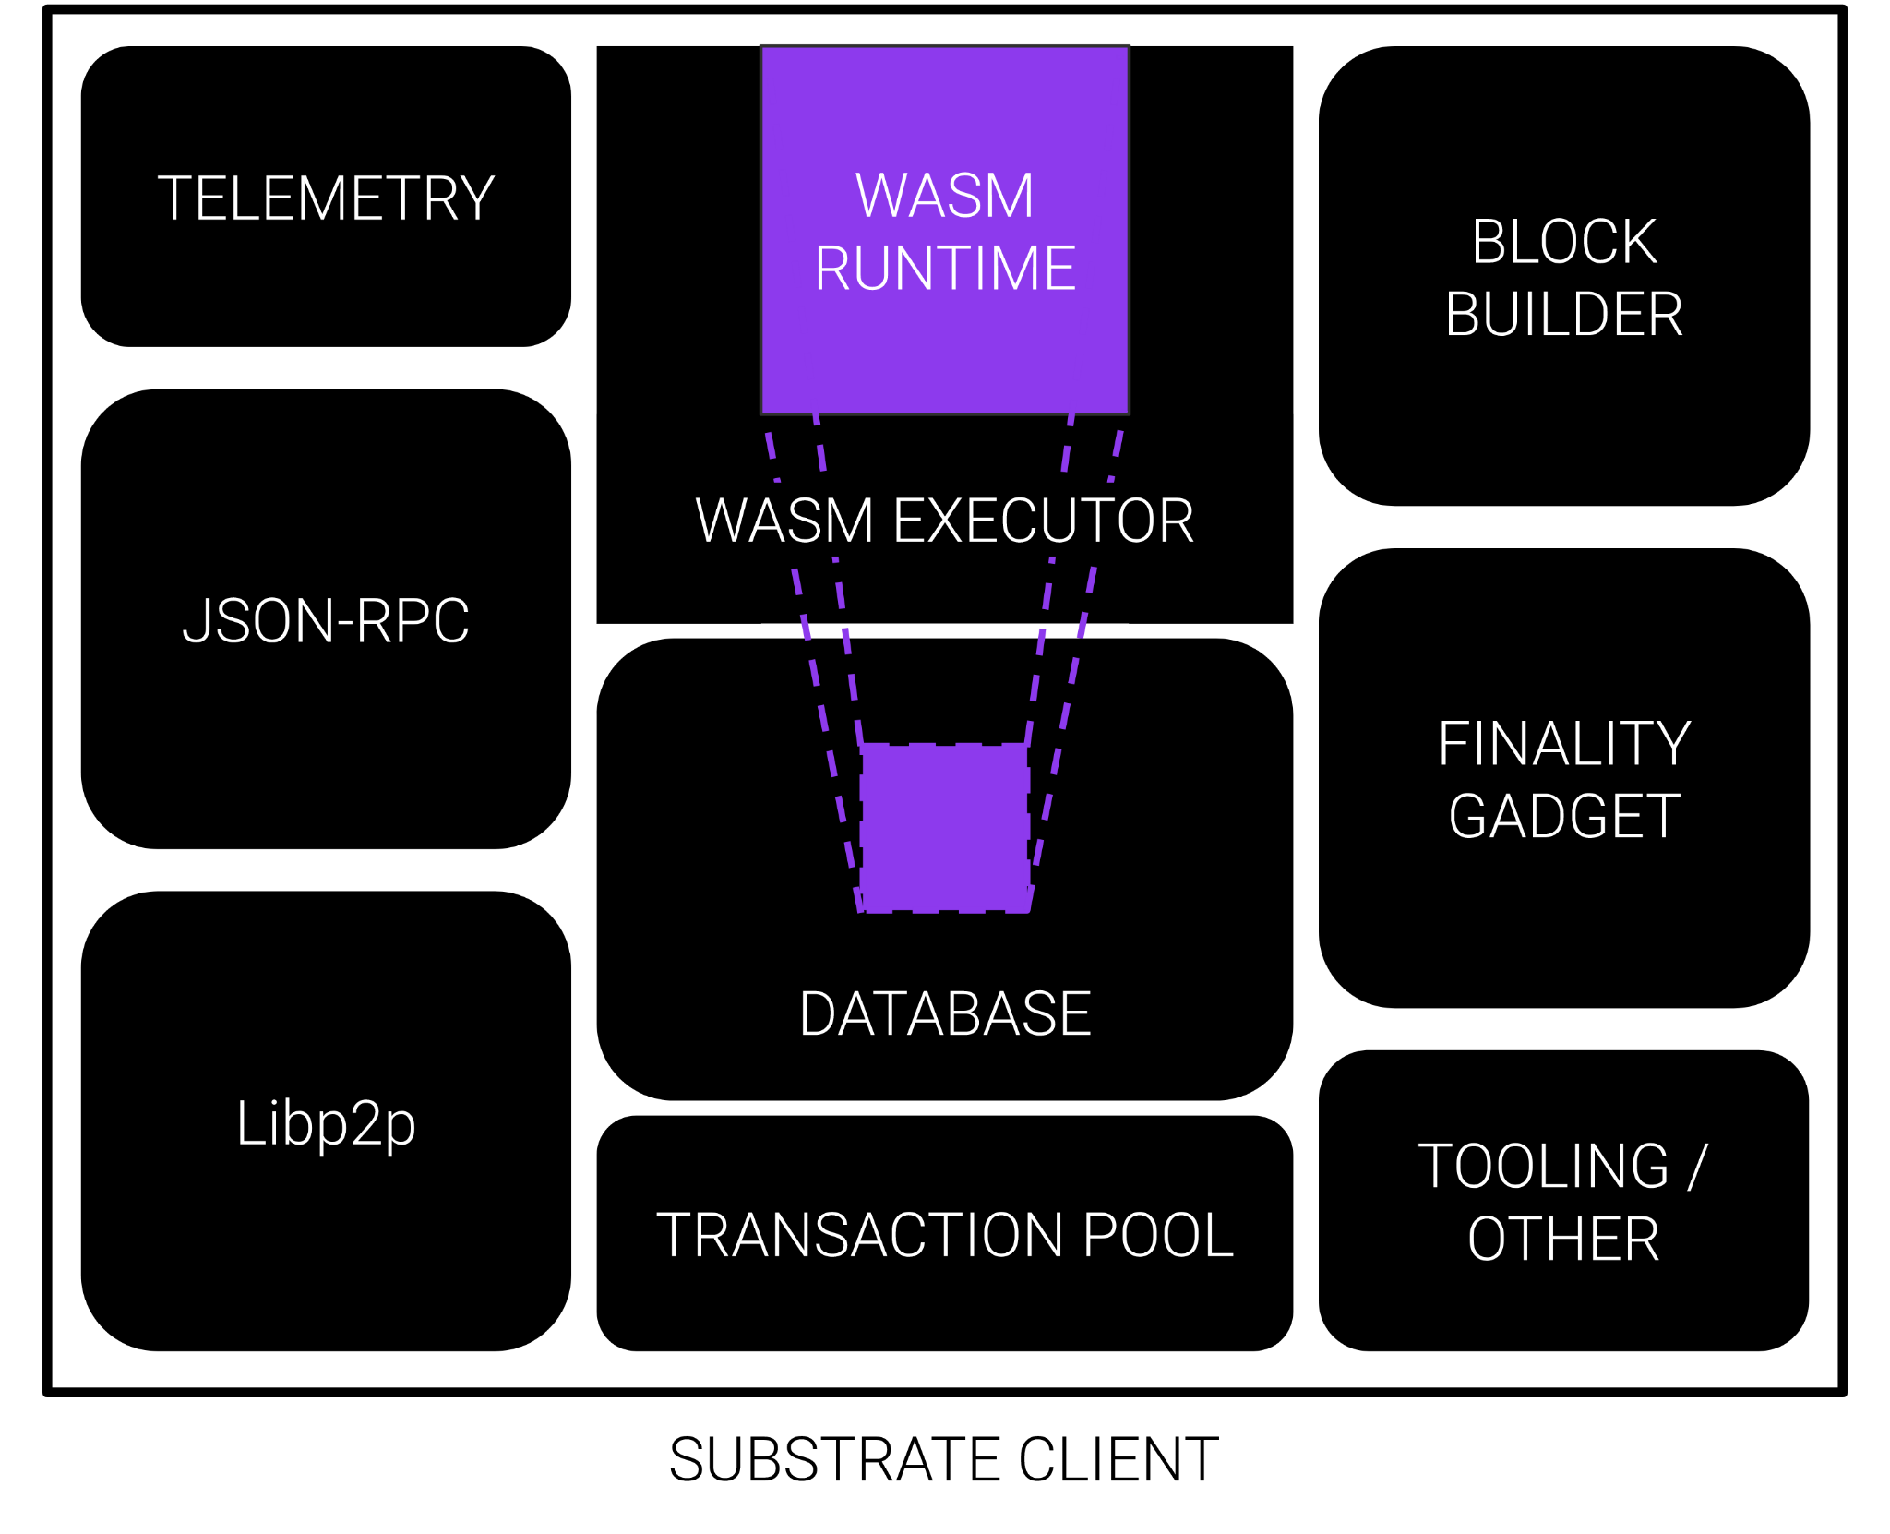
What does Substrate provide?
Client Components
Wasm Executor
Networking
Database
Transaction Pool
JSON-RPC
Consensus
Telemetry
Tools
And more!

Slide 11
What is the Runtime?
5
RUNTIME
system
babe
The runtime is the block execution logic of the blockchain, a.k.a. the State Transition Function.
It is composed of
FRAME Pallets.
indices
grandpa
sudo
timestamp
balances
Pallets Included with Substrate
assets | babe | balances | collective
contract | democracy | elections | grandpa
indices | grandpa | indices | membership
offences | session | staking | sudo
system | timestamp | treasury | and more...

Slide 12
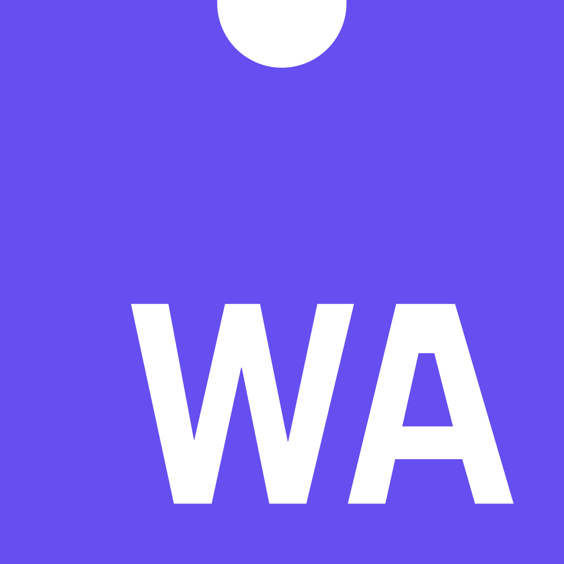
What is Wasm?
Wasm is an open executable format / meta-protocol:
Wasm is Sandboxed
Wasm is Fast
Wasm is Compact
Wasm is Well Supported

Slide 13
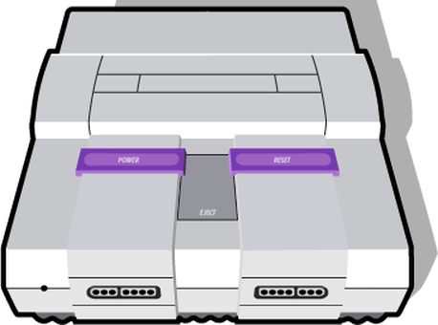
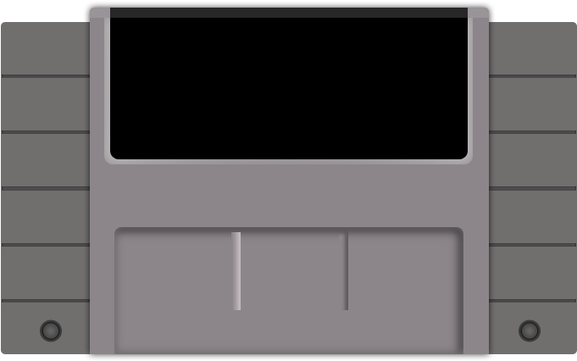
Game Console Analogy
Substrate Client
Wasm Runtime

Slide 14
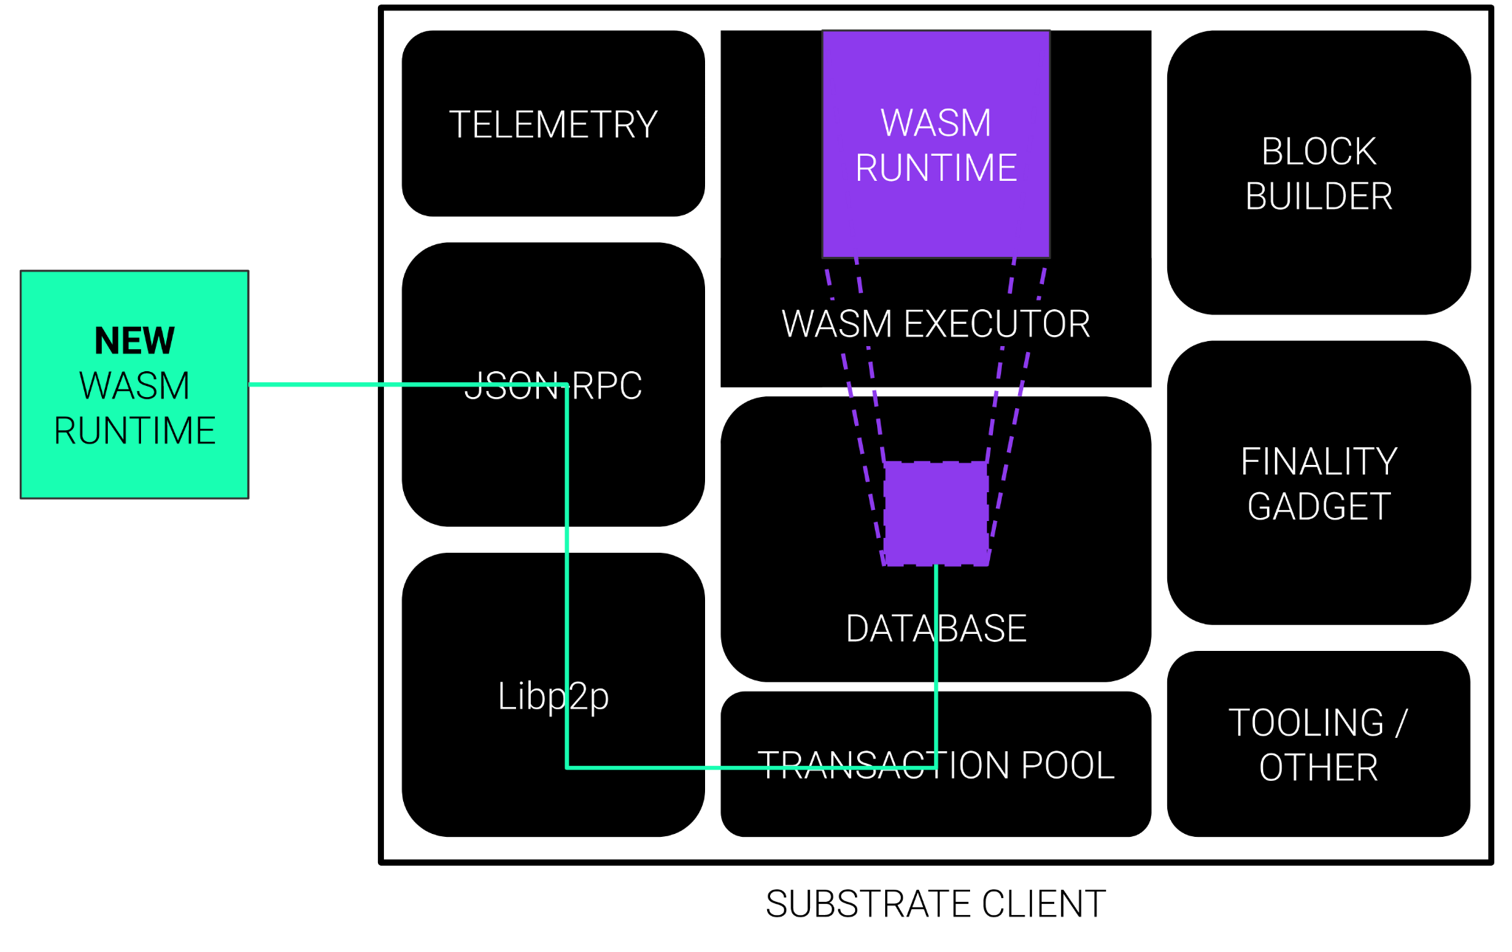
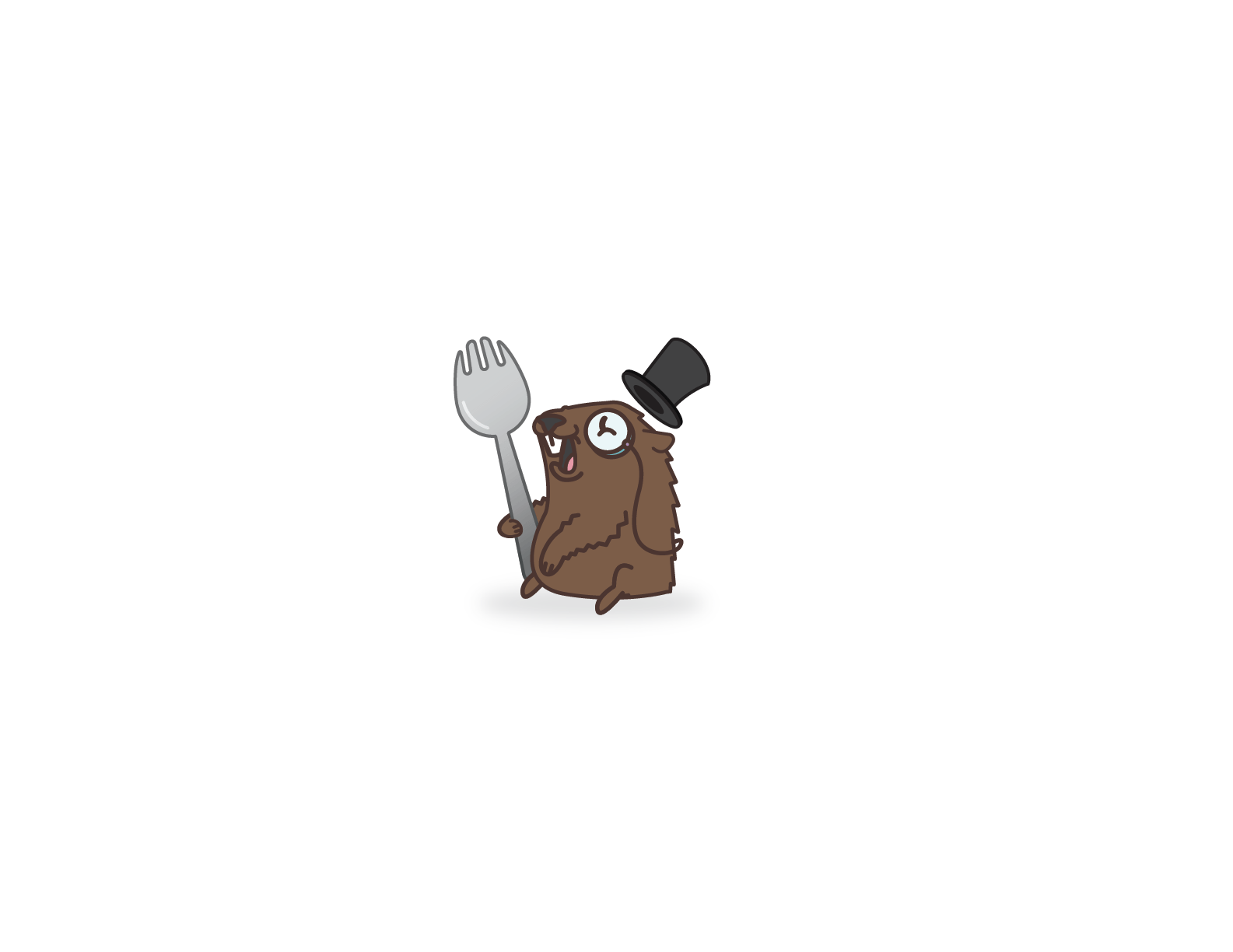
On-Chain, Forkless Runtime Upgrade

Slide 15
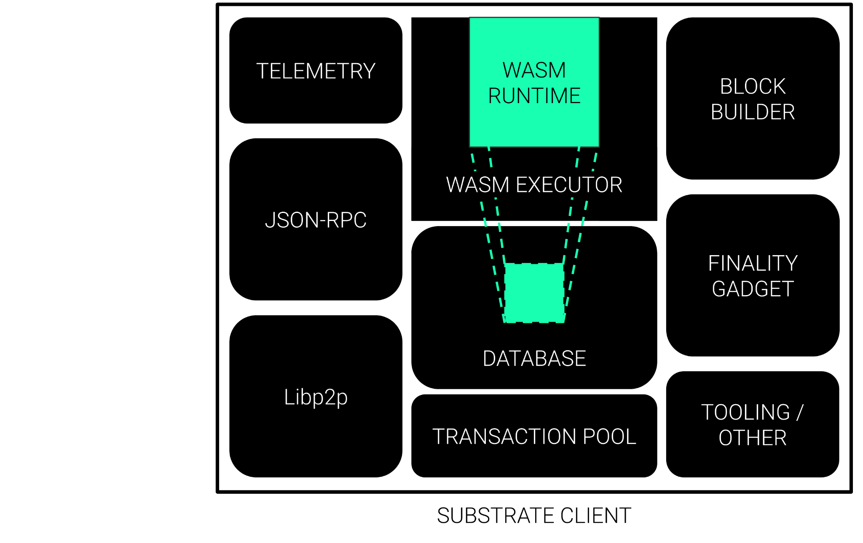
On-Chain, Forkless Runtime Upgrade

Slide 16
But Wasm does so much more…

Slide 17
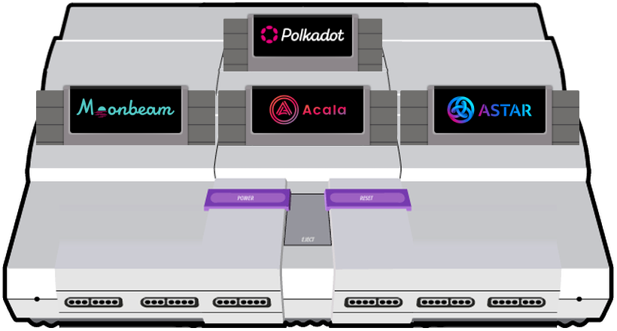
Polkadot is an All-In-One
What is Shared Security?
Date / Time:
Mar 02, 2023
16:40 - 17:00 MST
Location:
Stage #BUIDL Palace
National Western $SPORK Castle
4655 Humboldt St Denver CO 80202

Slide 18
Let’s Buidl…

Slide 19
https://docs.substrate.io
/tutorials/work-with-pallets
/use-macros-in-a-custom-pallet/

Slide 20
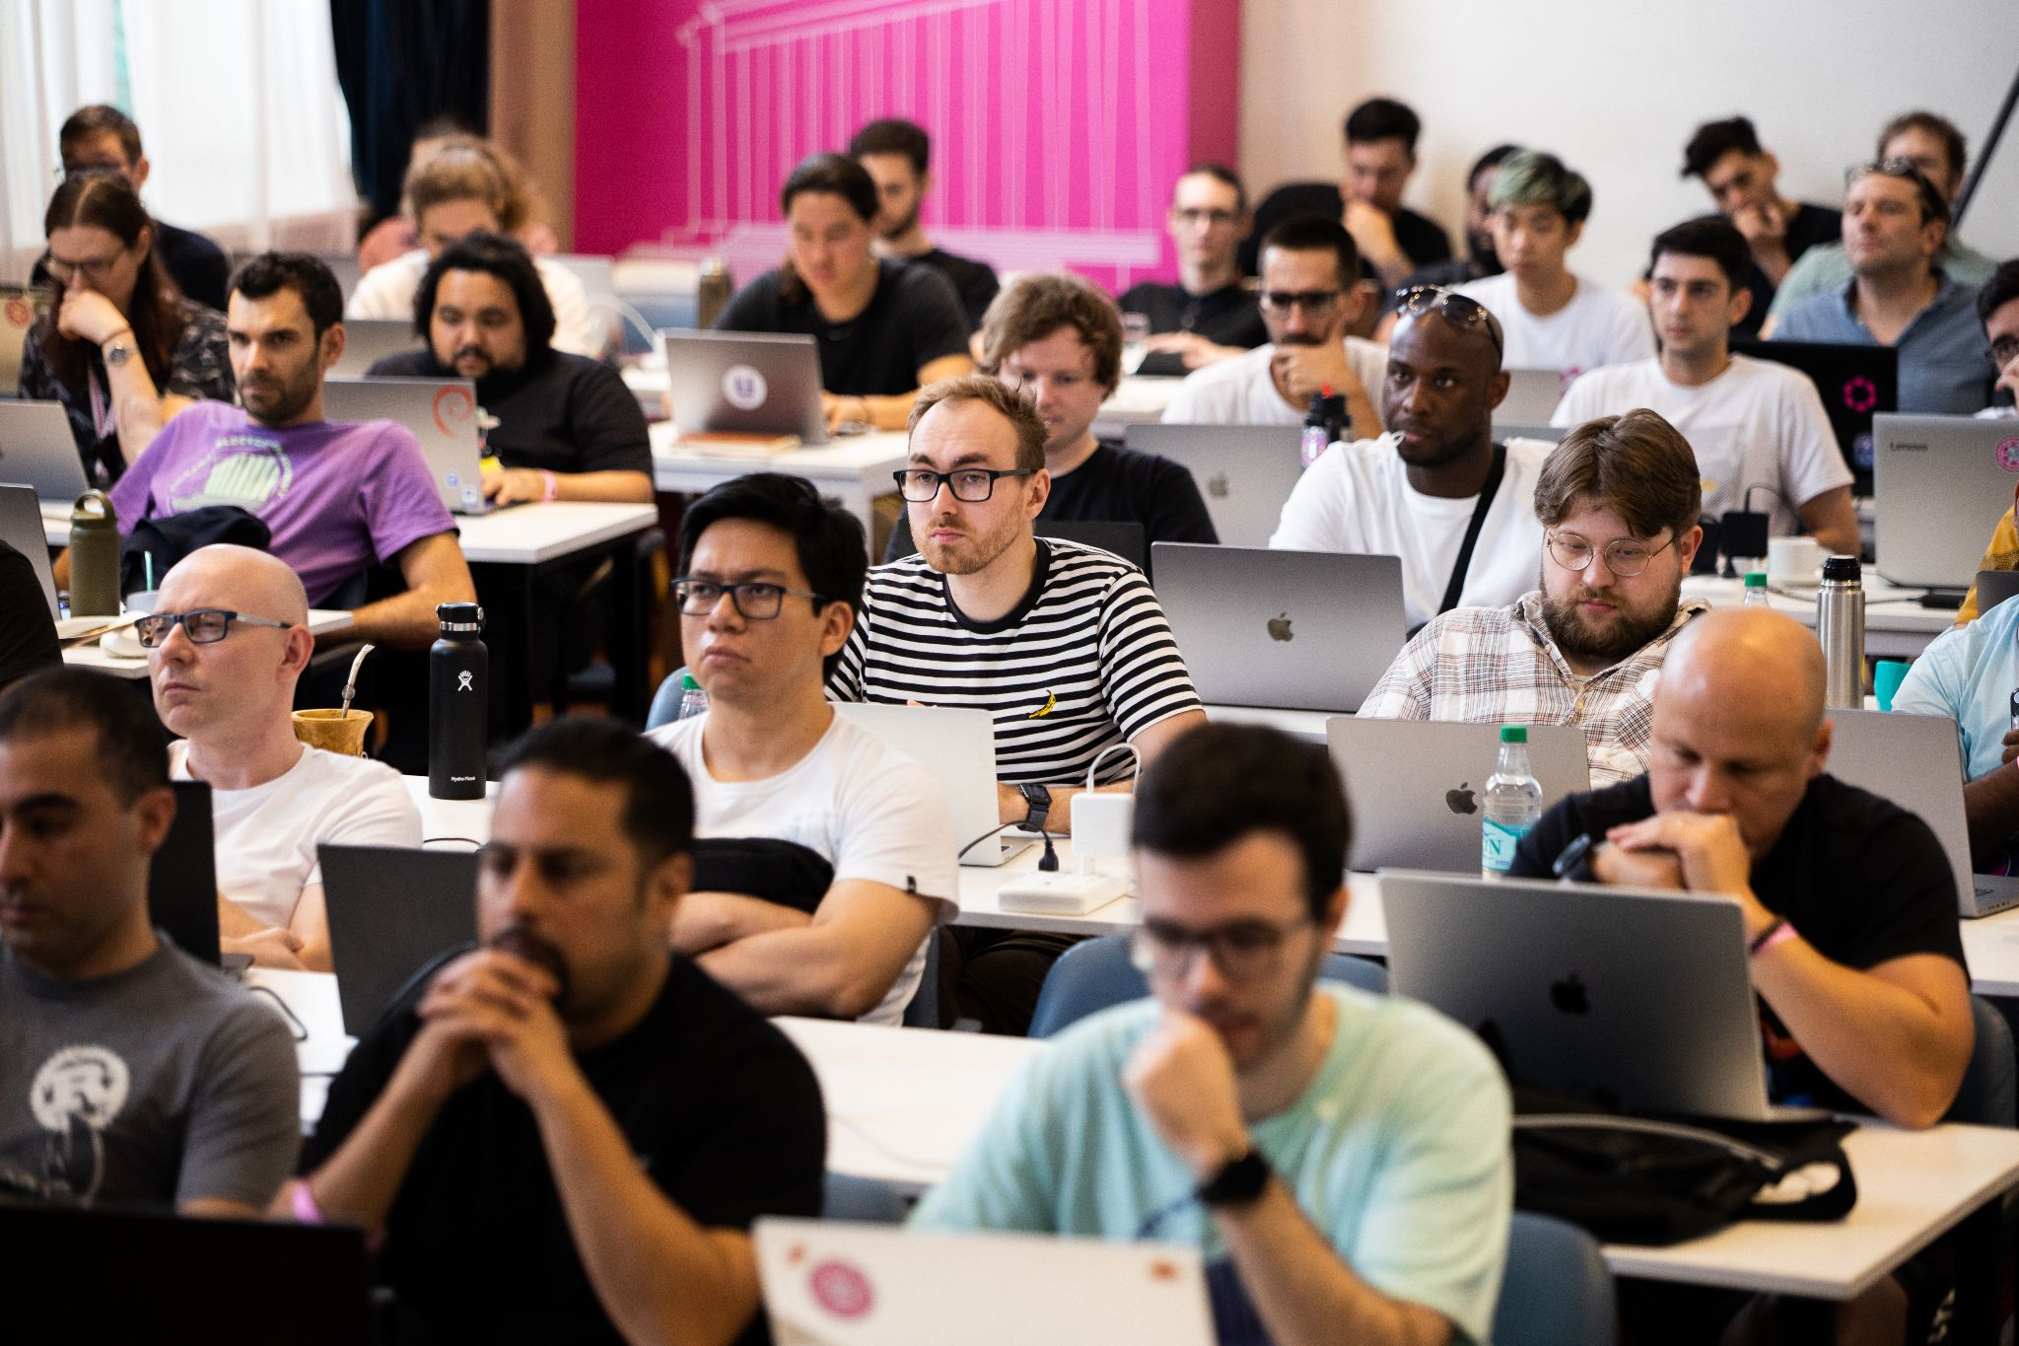
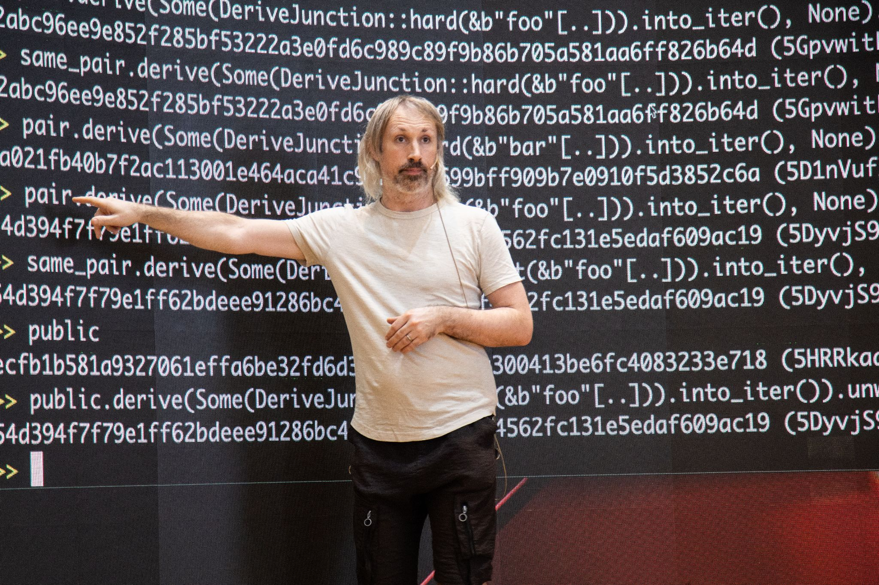
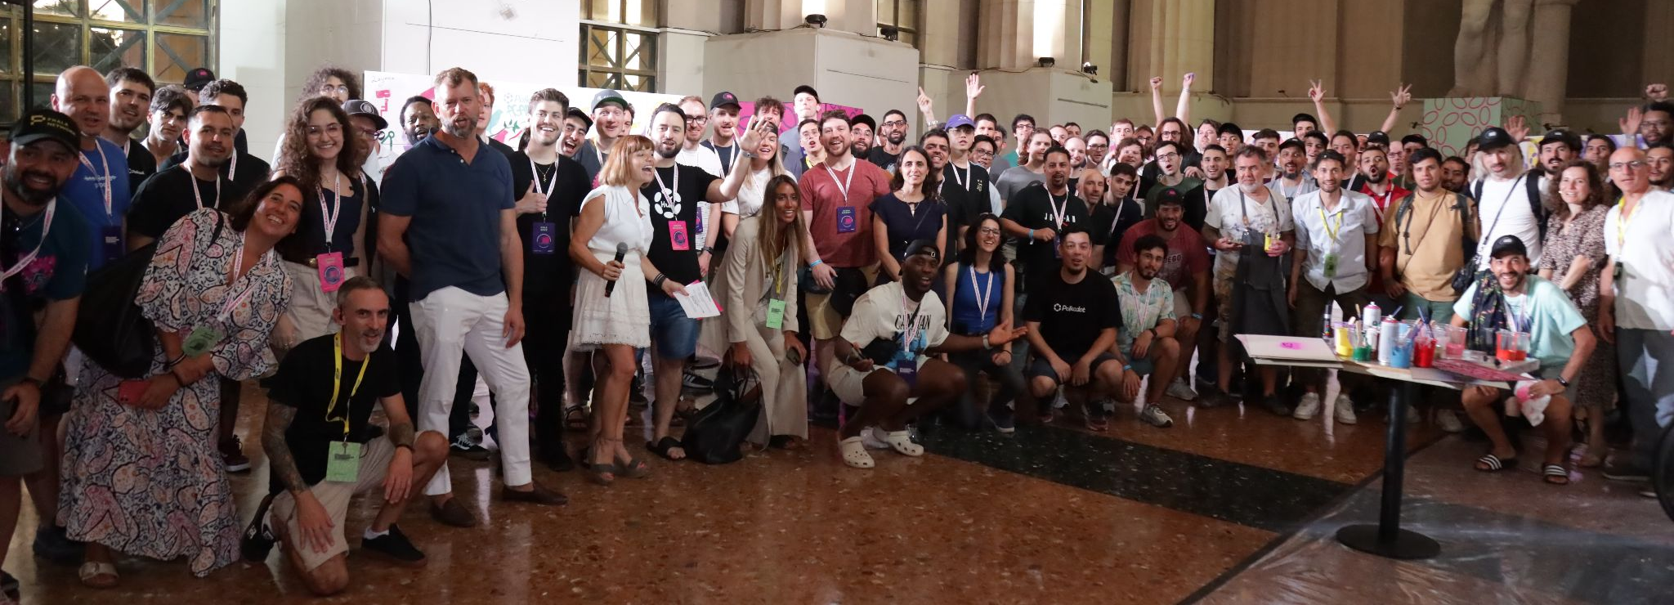
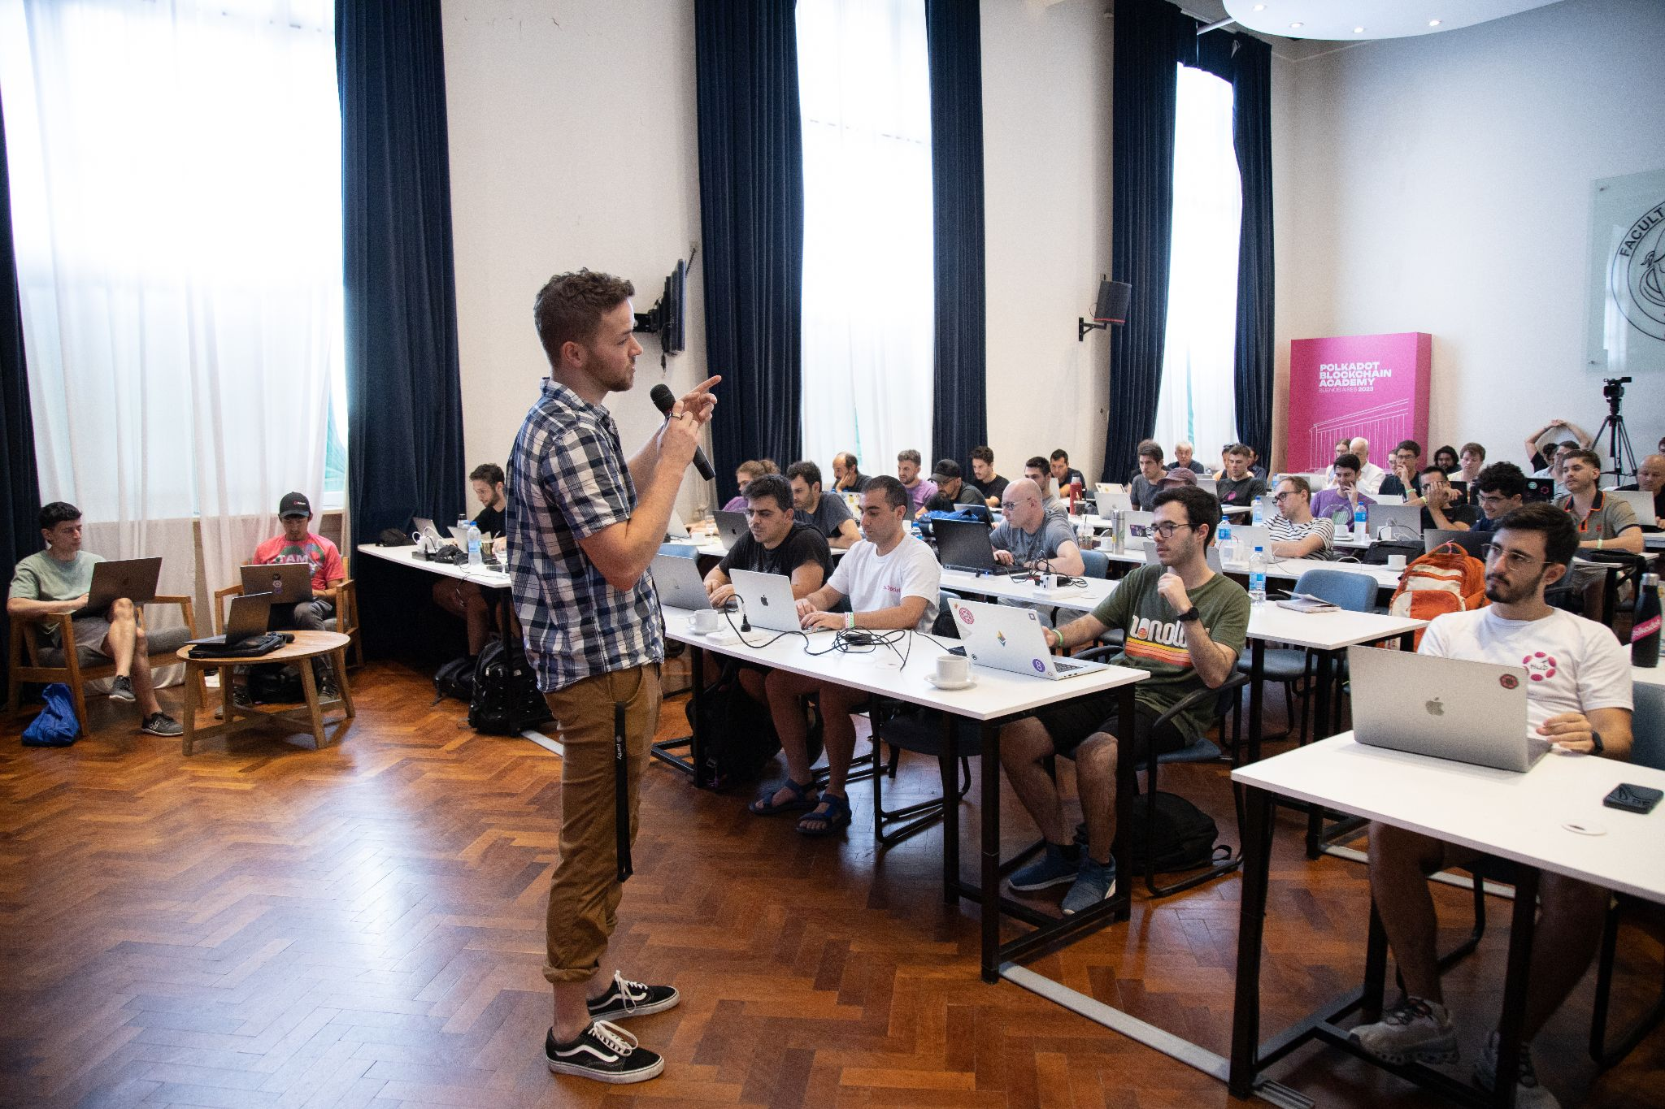
What is the Polkadot Blockchain Academy?
https://polkadot.network/academy/

Slide 21
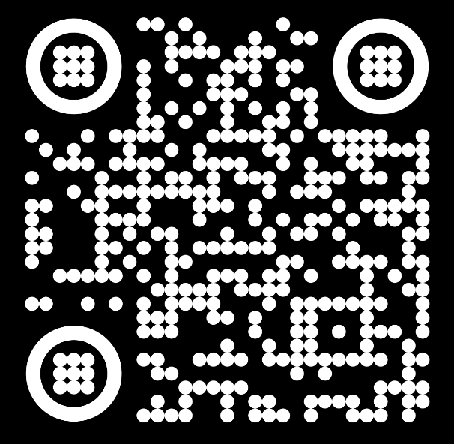
Apply Today for UC Berkeley, Summer 2023
The next cohort will happen in Berkeley, California in partnership with the Center for Responsible, Decentralized Intelligence at UC Berkeley, USA from July 10th until August 10th, 2023.
https://dot.li/pba_ethdenver23

